Slide 1
ME 233 Advanced Control II Lecture 17 Deterministic Input/Output Approach to SISO Discrete-Time Systems Repetitive Control
TexPoint fonts used in EMF.
Read the TexPoint manual before you delete this box.: AAAA

Slide 2
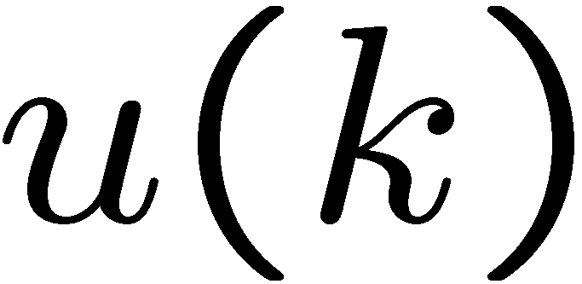
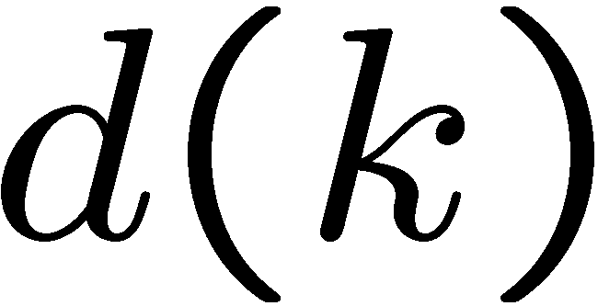
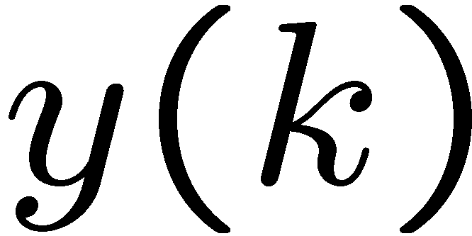
Deterministic SISO ARMA models
SISO ARMA model
Where all inputs and outputs are scalars:
control input
is a periodic disturbance of period N
output

Slide 3
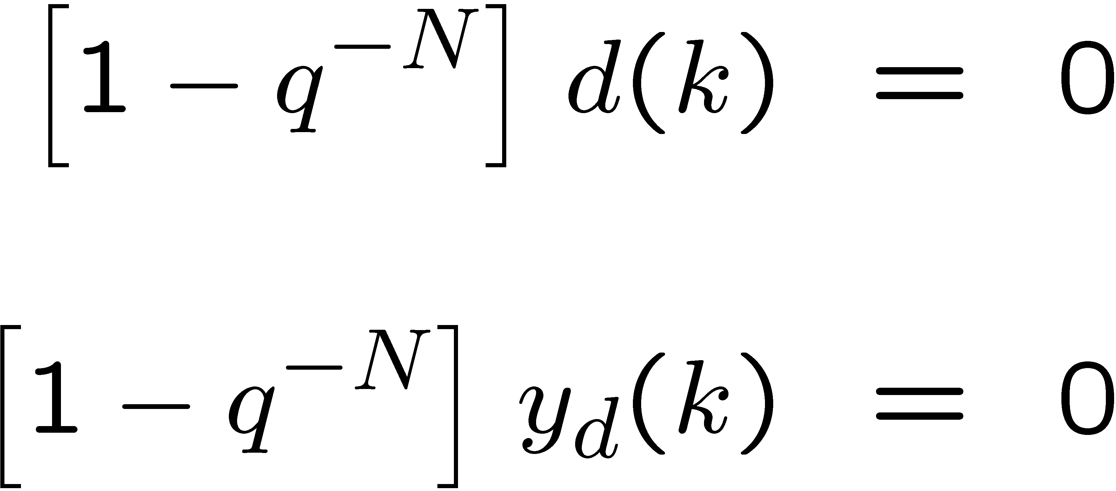
Repetitive control assumptions
Both the disturbance and the reference model output are periodic sequences,
where N is a known and large number

Slide 4
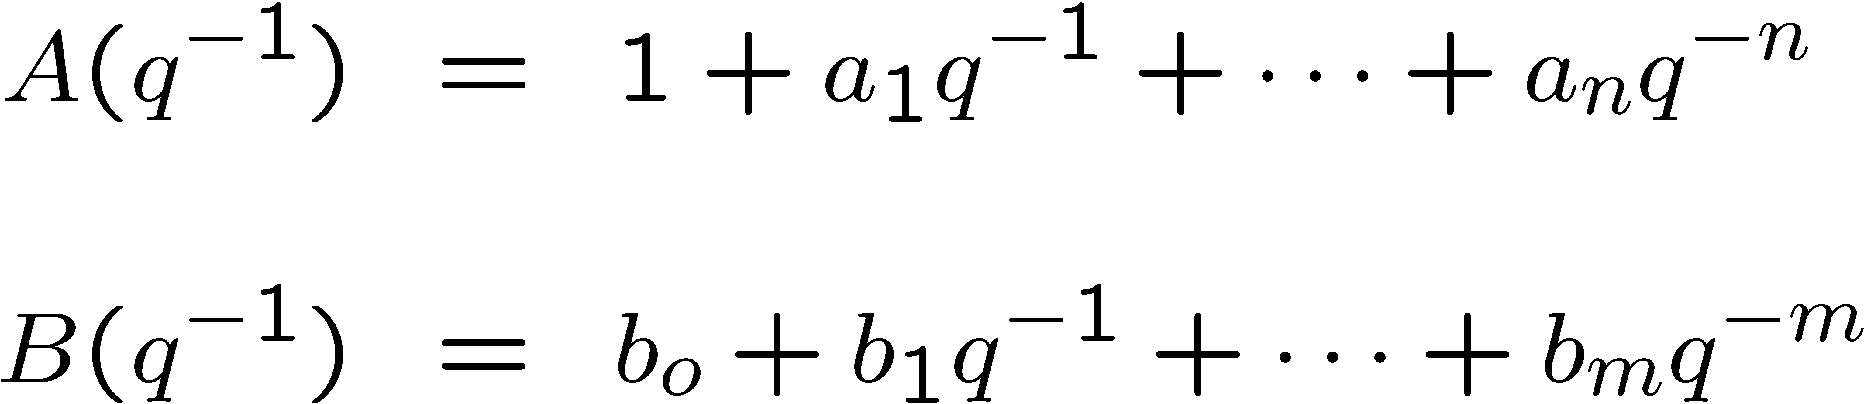
Deterministic SISO ARMA models
Where the polynomials
are co-prime and d is the known pure time delay
Also, the polynomials B(q⁻¹) and (1-q ^{-N}) are co-prime

Slide 5
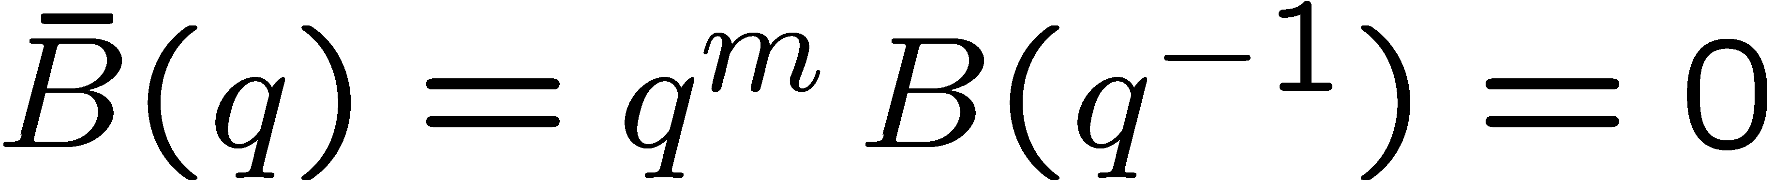
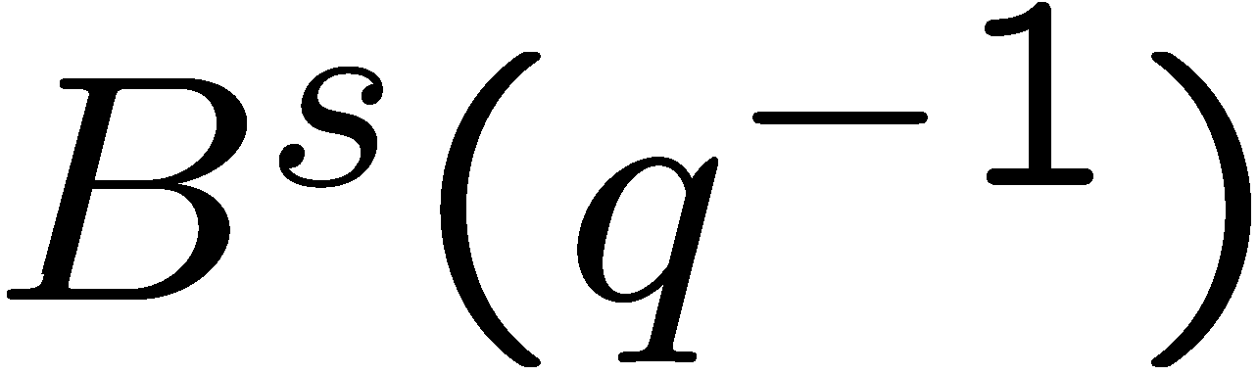
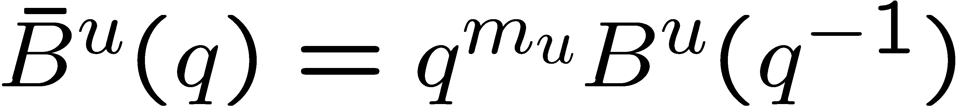
Deterministic SISO ARMA models
The zero polynomial:
has
m_{u} zeros that we do not want to cancel.
m_{s} zeros inside the unit circle (asymptotically stable) that we do want to cancel.
is anti-Schur
has the zeros (in q) that we do not want to cancel

Slide 6
Deterministic SISO ARMA models
The zero polynomial:
Without loss of generality, we will assume that

Slide 7
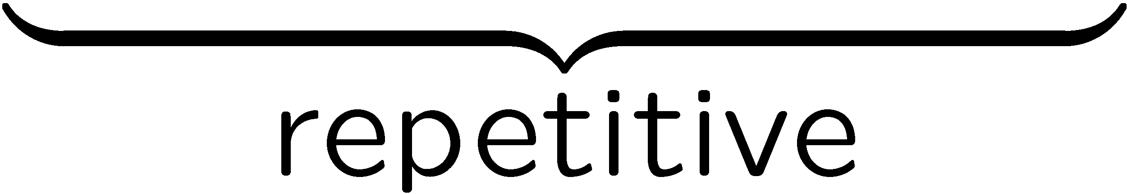
Block Diagram
Control strategy: We design the controller in two stages
Minor-loop pole placement: Place minor-loop poles
(these will be cancelled later)
2. Repetitive compensator: Reject periodic disturbance
Follow periodic reference

Slide 8
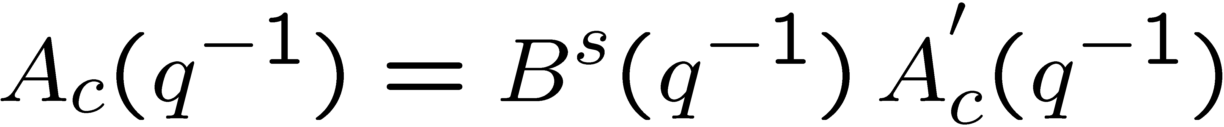
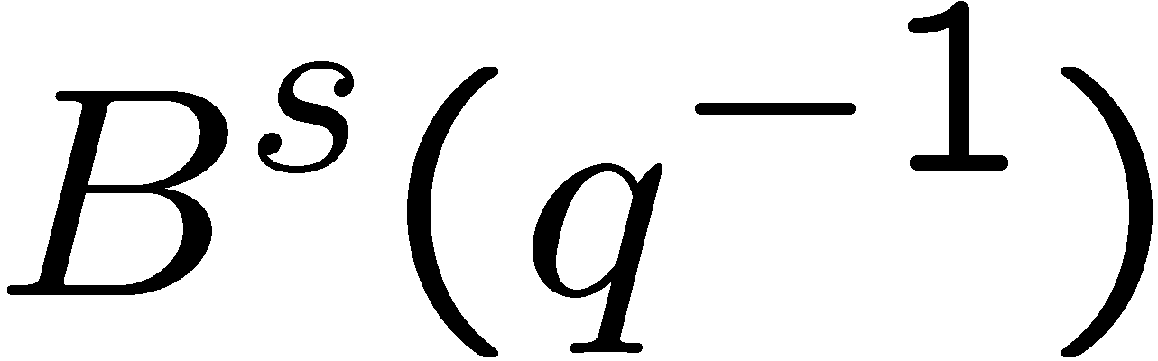
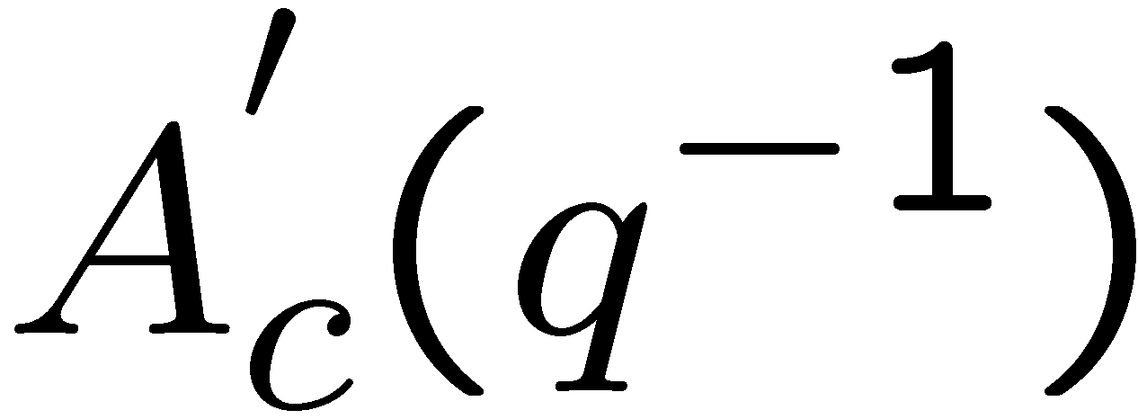
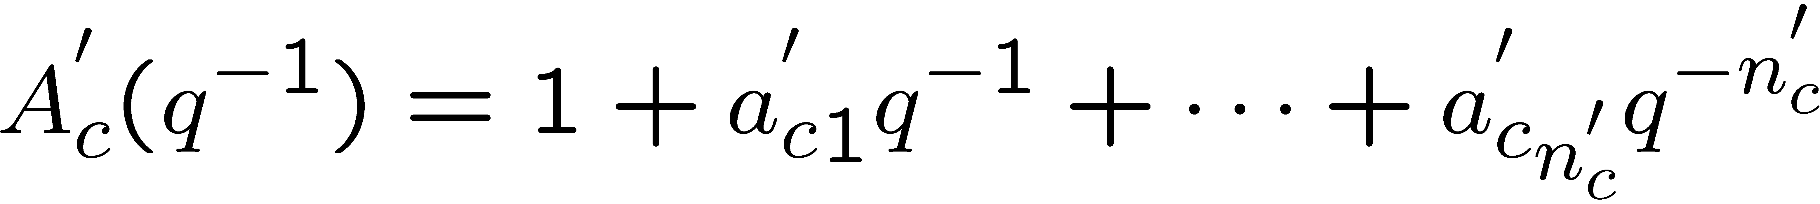
Control Objectives
Minor-loop Pole Placement: The poles of the minor-loop system are placed at specific locations in the complex plane. They will be cancelled later.
Minor-loop pole polynomial:
Where:
cancelable plant zeros
anti-Schur polynomial chosen by the designer

Slide 9
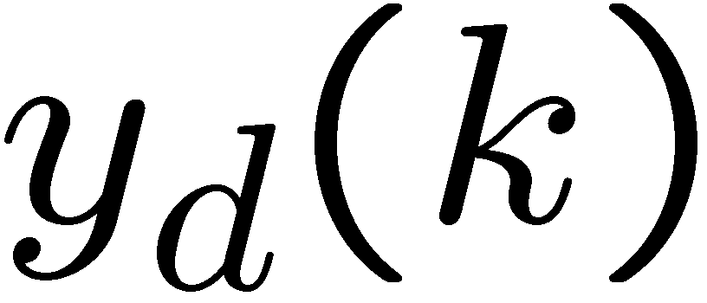
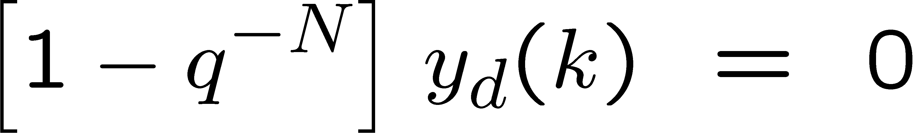
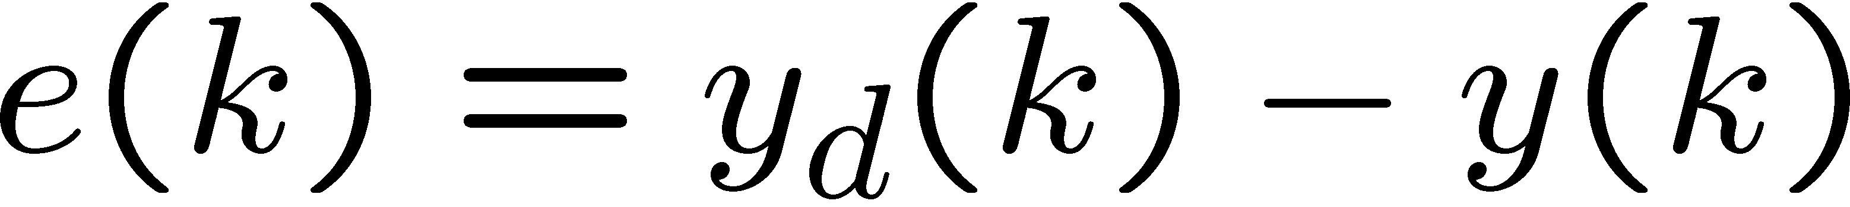
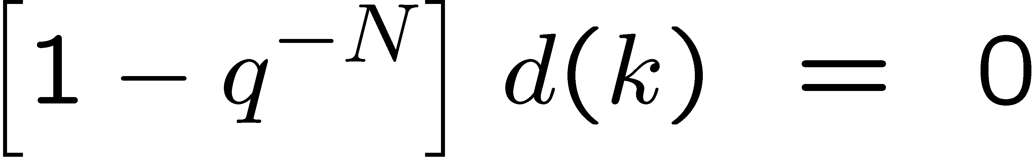
Control Objectives
2. Tracking: The output sequence must asymptotically follow a reference sequence which is periodic
Error signal:
3. Disturbance rejection: The closed loop system must reject a class of deterministic disturbances which satisfy

Slide 10
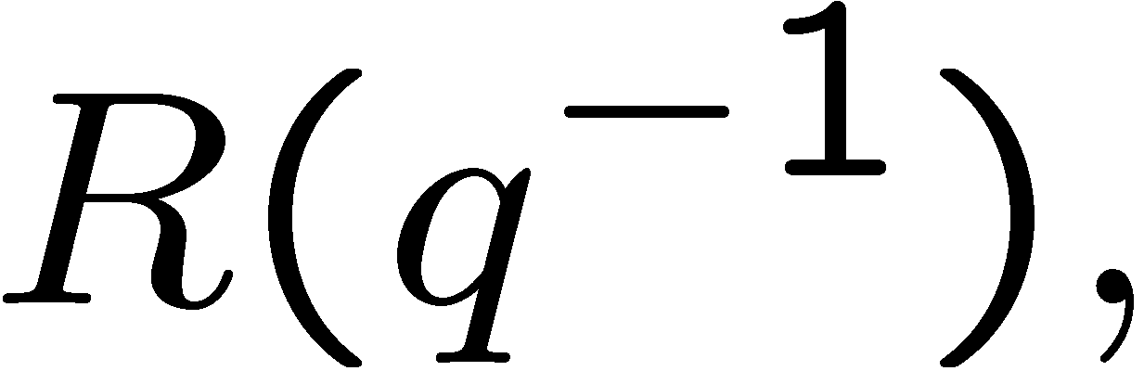
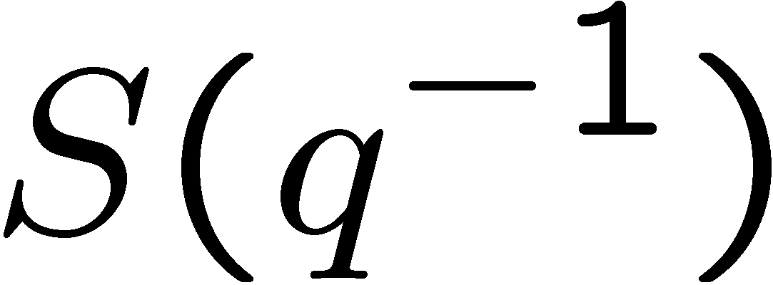
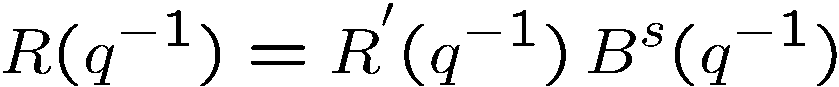
Step1: Minor-loop pole placement
Diophantine equation: Obtain polynomials
that satisfy:
Closed-loop poles
Plant poles
plant zeros
We will factor
out the
polynomial next
The disturbance annihilating polynomial has not been included

Slide 11
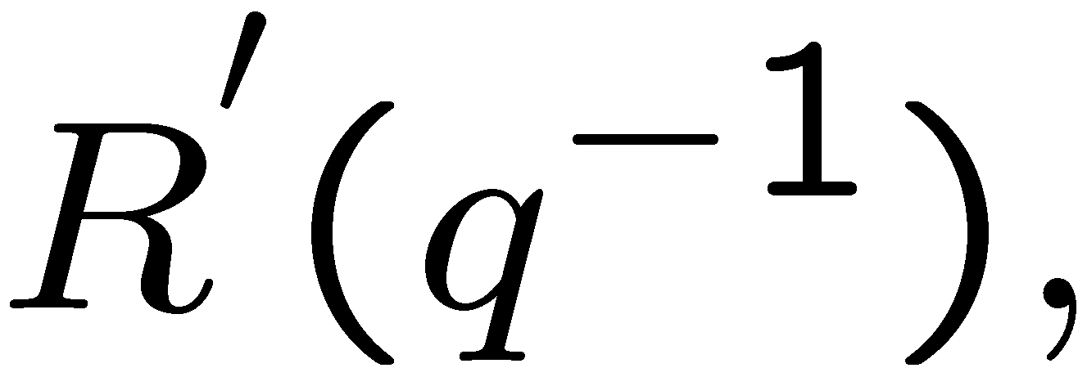
Minor-loop pole placement
Diophantine equation: Obtain polynomials
which satisfy:
Closed-loop
poles
Plant poles
Unstable plant zeros
The disturbance annihilating polynomial has not been included

Slide 12
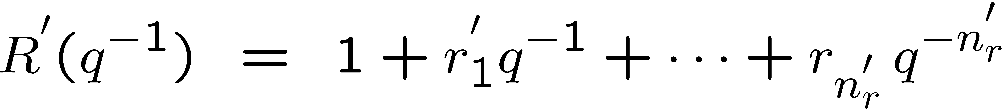
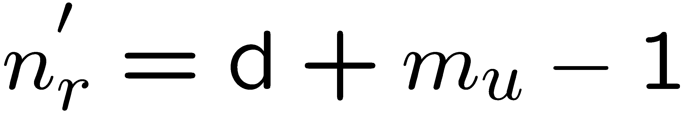
Diophantine equation
Solution:

Slide 13
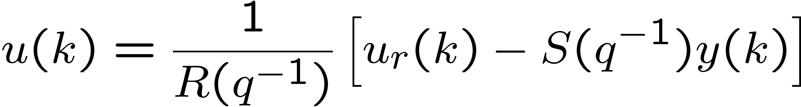
Minor-loop pole placement

Slide 14
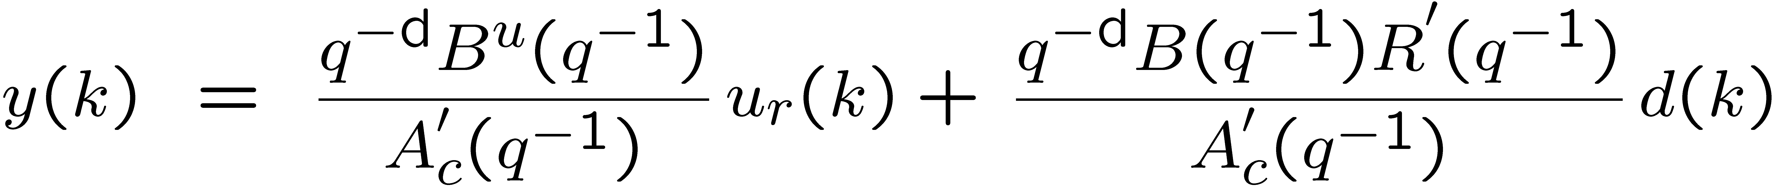
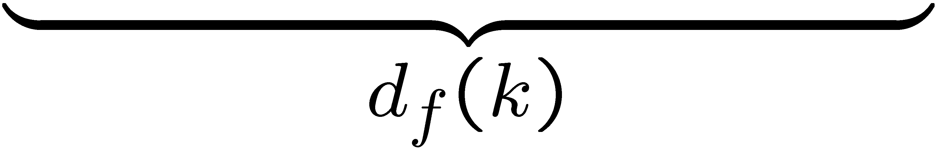
Minor-loop pole placement
Closed-loop dynamics
filtered repetitive disturbance

Slide 15
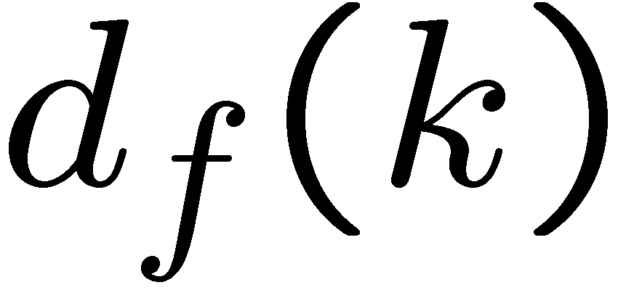
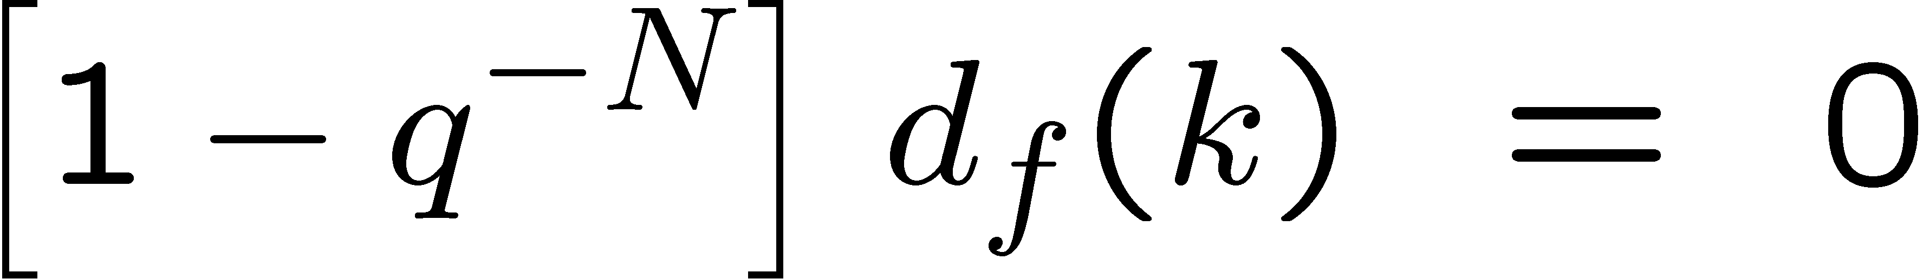
Equivalent Block Diagram
repetitive
compensator
Notice that is still a periodic disturbance

Slide 16
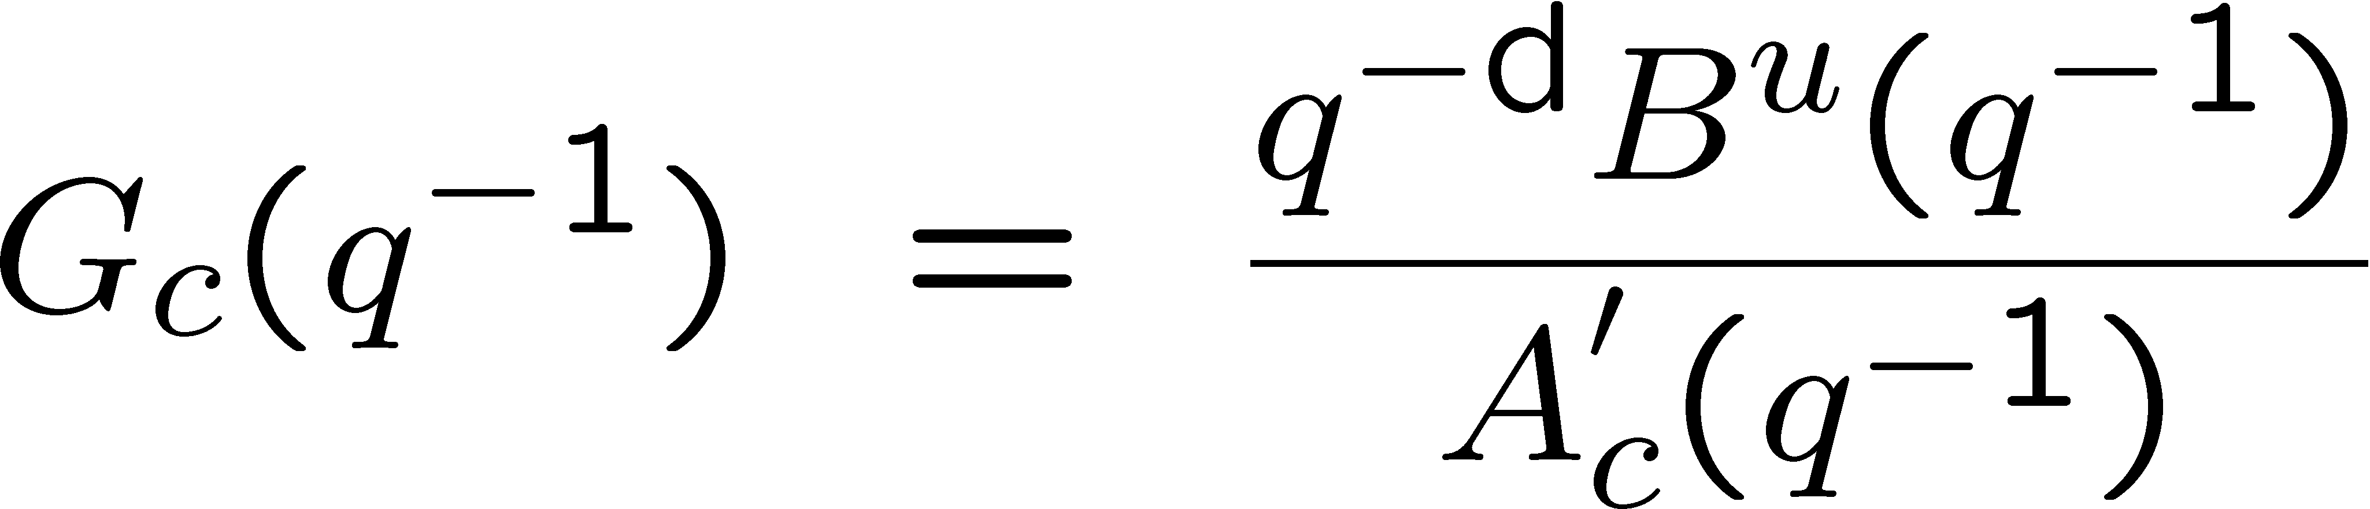
Equivalent Block Diagram
repetitive
compensator
where

Slide 17


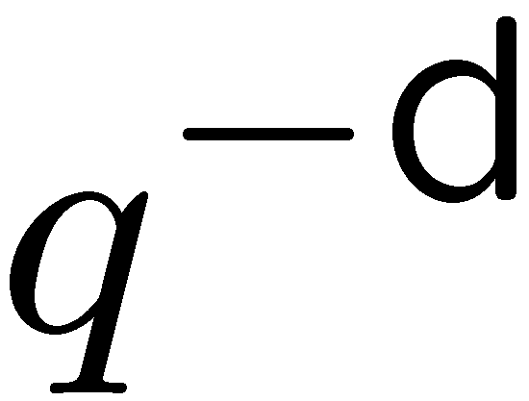
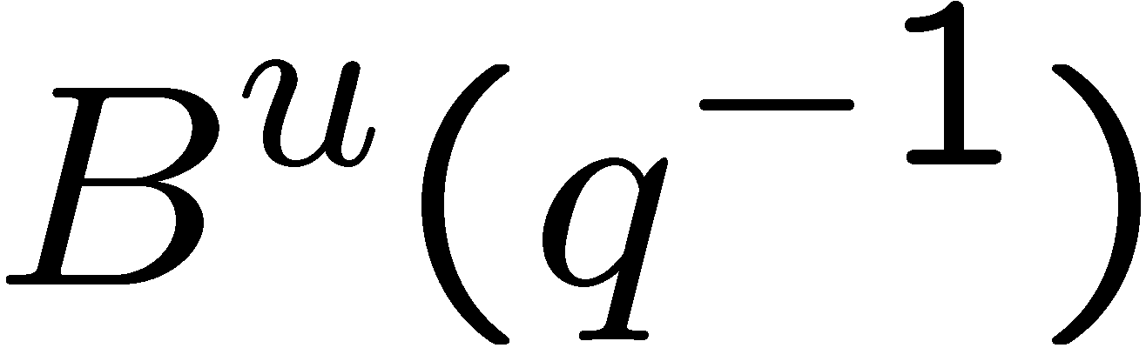
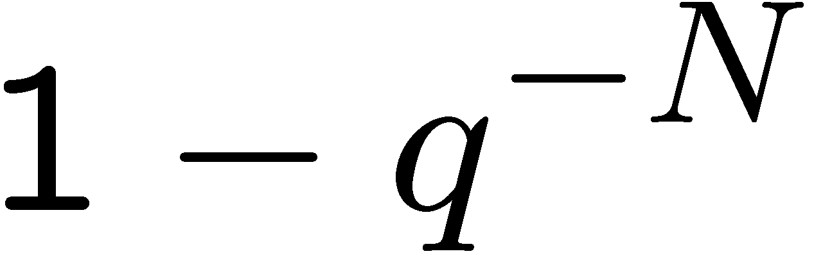
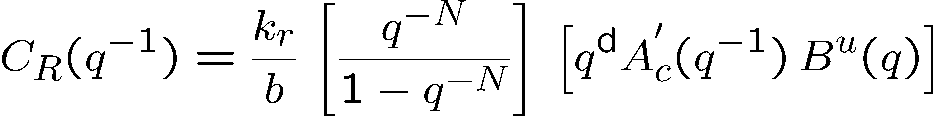
Repetitive Compensator
repetitive
compensator
Repetitive compensator strategy:
Cancel stable poles and delay
Zero-phase error compensation for
Include annihilating polynomial in the denominator
Not q ⁻¹

Slide 18
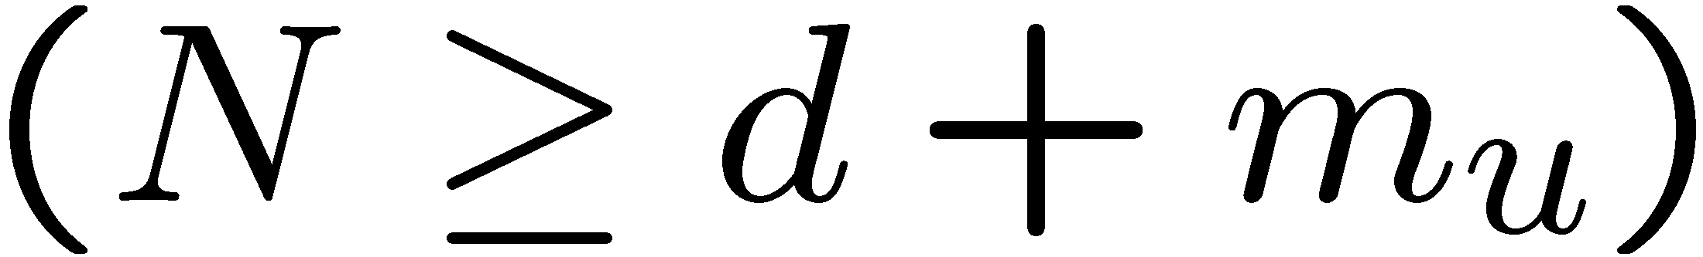
Repetitive Compensator
Repetitive compensator :
so that C_{R} is implementable

Slide 19
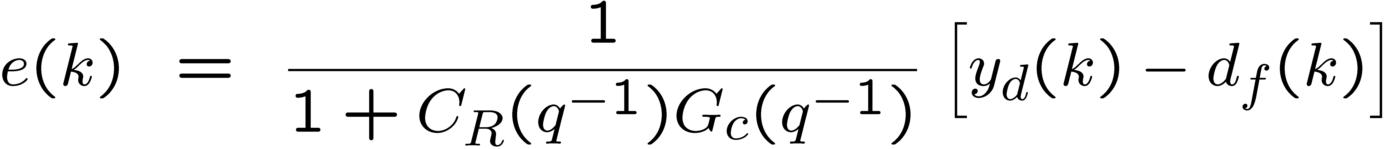
Repetitive Compensator
Closed-loop dynamics

Slide 20
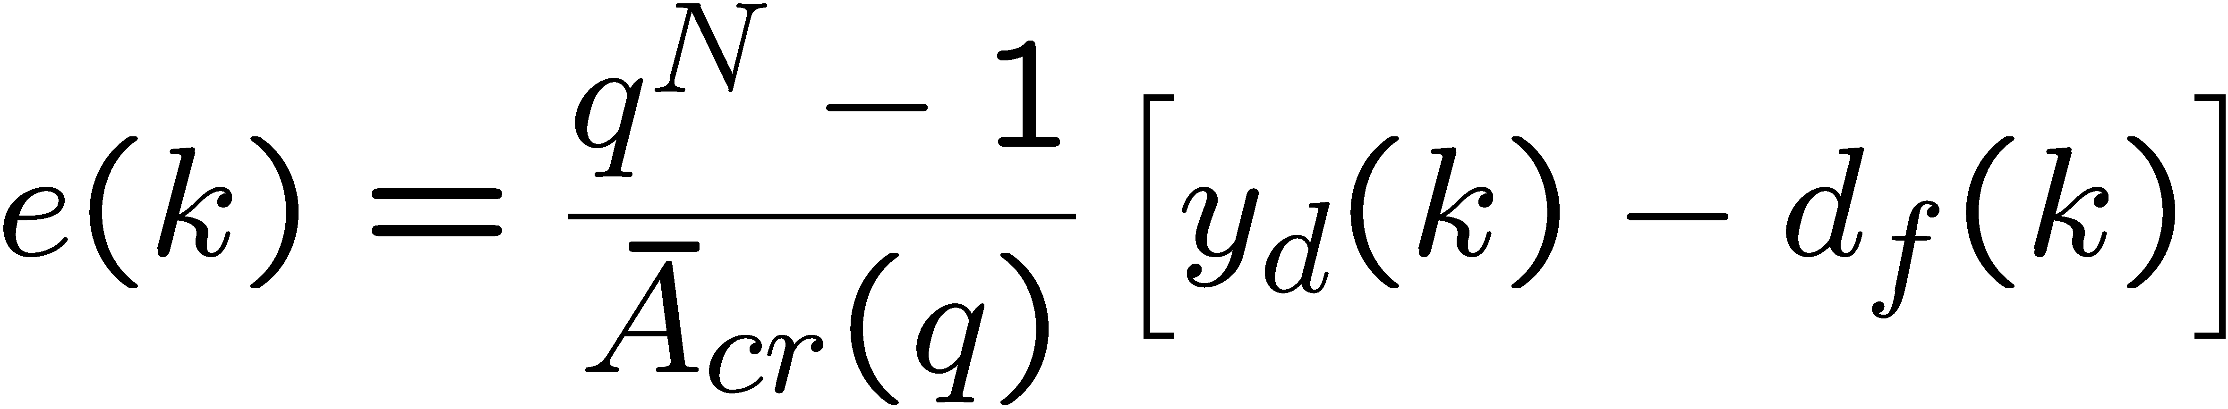
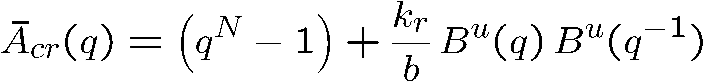
Repetitive Controller
Closed-loop dynamics: doing a bit of algebra, we obtain,
Where the closed-loop poles are the zeros of

Slide 21
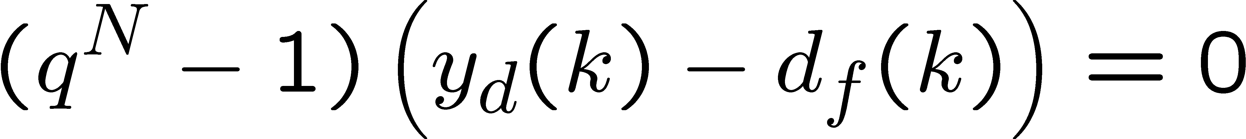
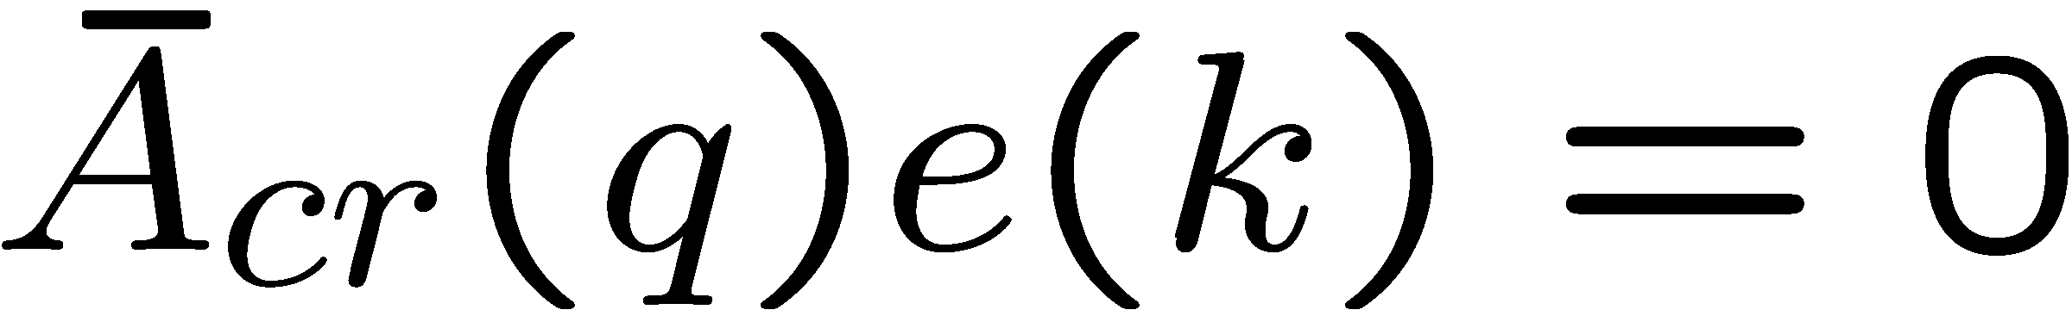
Repetitive Controller
since,
we obtain
Where

Slide 22
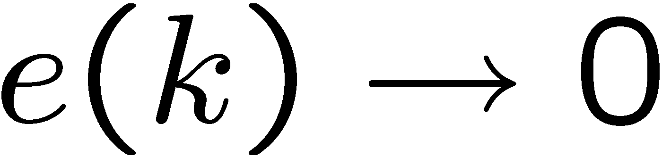
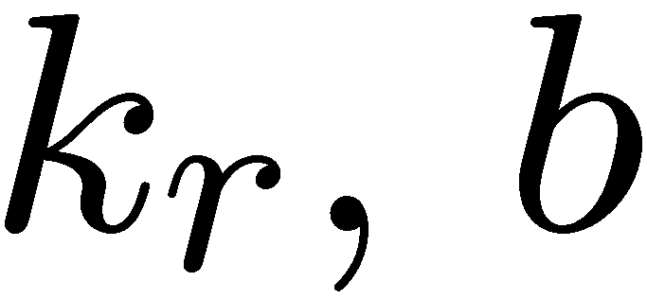
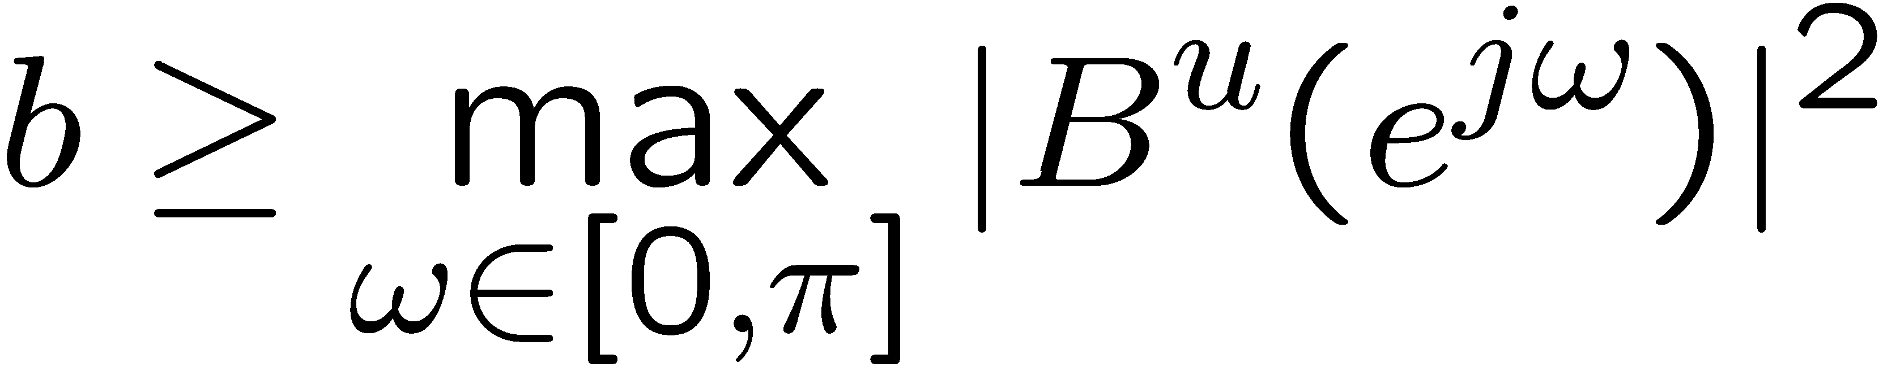
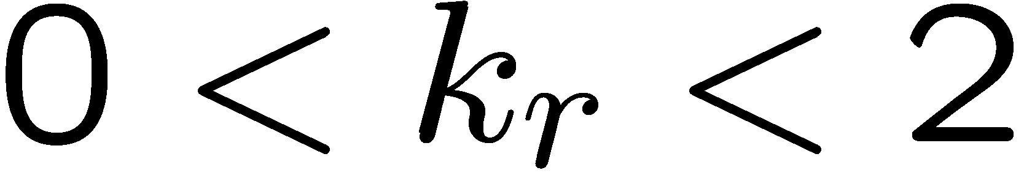
Repetitive Controller
Theorem
The tracking error if the gains
are selected as follows:
1.
2.

Slide 23
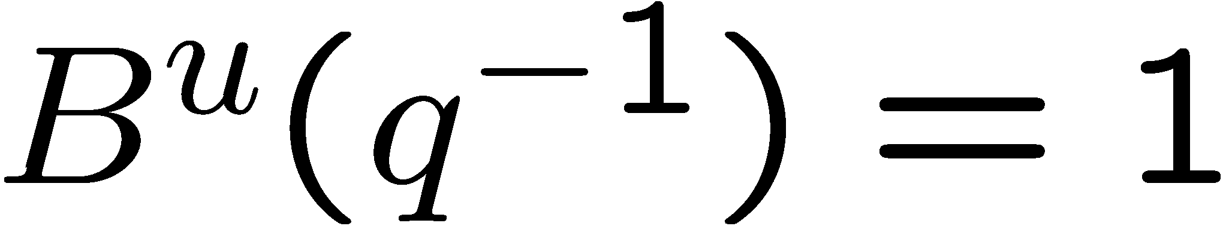
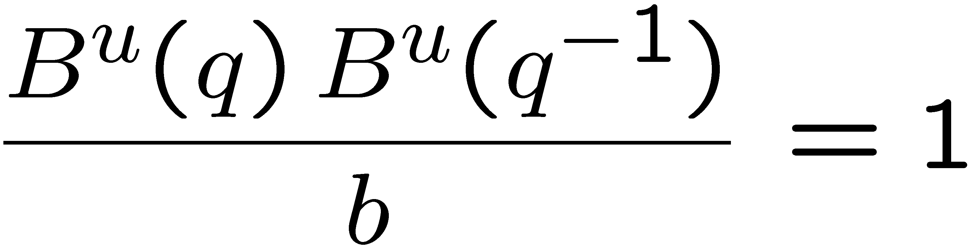
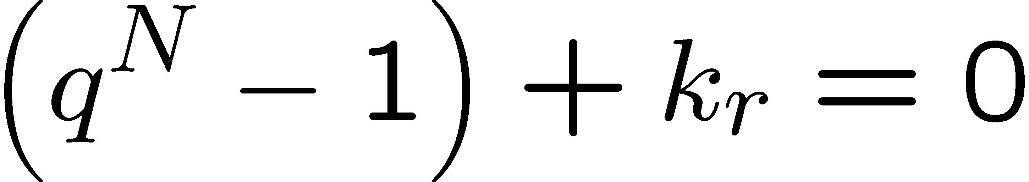
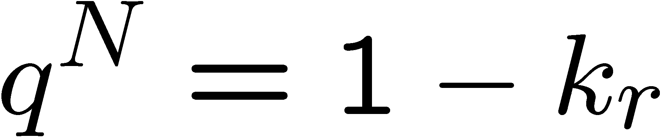
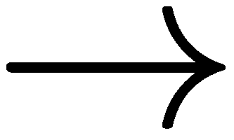
Closed-loop poles for minimum phase zeros
Consider now the case when there are no unstable zeros,
e.g.
choose b = 1 so that
Then the closed-loop poles are given by

Slide 24
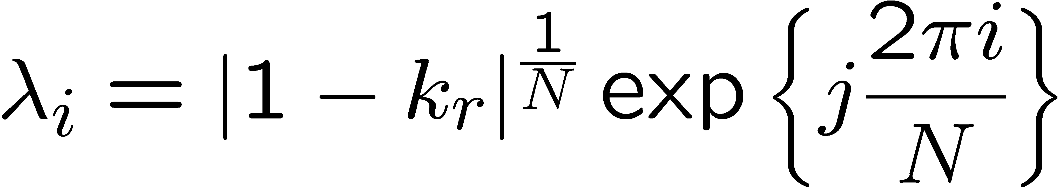
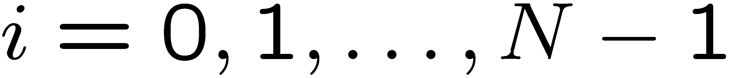

Closed-loop poles for minimum phase zeros
For the case when the are no unstable zeros,
the closed-loop poles are given by the roots of
When 0 < k_{r} < 2, we have
N asymptotically stable closed-loop poles
Case 1: 0 < k_{r} · 1
Case 1: 1 < k_{r} < 2

Slide 25






Repetitive control example
Assume that N = 4
Choose

Slide 26




Repetitive control example
Open-loop TF
Closed-loop poles:

Slide 27


Closed-loop poles for non-minimum phase zeros
Now consider the general case, i.e. there are unstable zeros
Assume that we have chosen b such that
The closed-loop poles are the roots of

Slide 28



Closed-loop poles for non-minimum phase zeros
The closed-loop poles are the roots of

Slide 29


Closed-loop poles for non-minimum phase zeros
Therefore is equivalent to

Slide 30



Closed-loop poles for non-minimum phase zeros
By Nyquist’s theorem, the closed-loop system is asymptotically stable if there are no encirclements around –1.
This is guaranteed if the following hold for

Slide 31








Closed-loop poles for non-minimum phase zeros
Case 1:
We have

Slide 32





Closed-loop poles for non-minimum phase zeros
Case 2:
We have
Since B^{u}(q⁻¹) and 1-q ^{-N} are co-prime, we have that
Closed-loop stability

Slide 33
Repetitive Compensator
Repetitive compensator:
The controller has N open-loop poles
on the unit circle

Slide 34


Repetitive control example
Assume that N = 4
Choose

Slide 35
Repetitive control example
Open-loop TF
Closed-loop poles:

Slide 36



Repetitive control, inexact cancellation
Assume that N = 4
Plant:
But, unmodeled dynamics are not cancelled
therefore,

Slide 37

Repetitive control, inexact cancellation
Open loop TF
Closed-loop poles:

Slide 38
Repetitive control, inexact cancellation
Repetitive control is not robust to unmodeled dynamics
Closed-loop poles:

Slide 39


Robust Repetitive Compensator
Add Q-filter
moving average filter with zero-phase shift
characteristics
Controller’s N open-loop poles are no longer on the unit circle

Slide 40

Robust Repetitive Compensator
moving average filter with zero-phase shift
characteristics
has unit DC gain and gain decreases as
frequency increases

Slide 41


Robust Repetitive Compensator
Notice that the disturbance d(k) is no longer completely
annihilated, since
However, with a proper choice of Q filter,

Slide 42


Robust Rep. control, inexact cancellation
Assume that N = 4
Plant:
But, unmodeled dynamics are not cancelled
where,

Slide 43

Robust Rep. control, inexact cancellation
Closed-loop poles:
Closed-loop system is
asymptotically stable for
a finite range of k_{r}

